Slide 1

Improve Sales Opportunities for Next Quarter
Md Islam
2024

Slide 2
Table of Contents
Framing the Question
Descriptive Statistics
Profit Analysis
Monthly Sales Trends
Price Vs. Quantity Sold
Recommendation

Slide 3
Question
How can the VP of sales improve sale opportunities by next quarter?

Slide 4
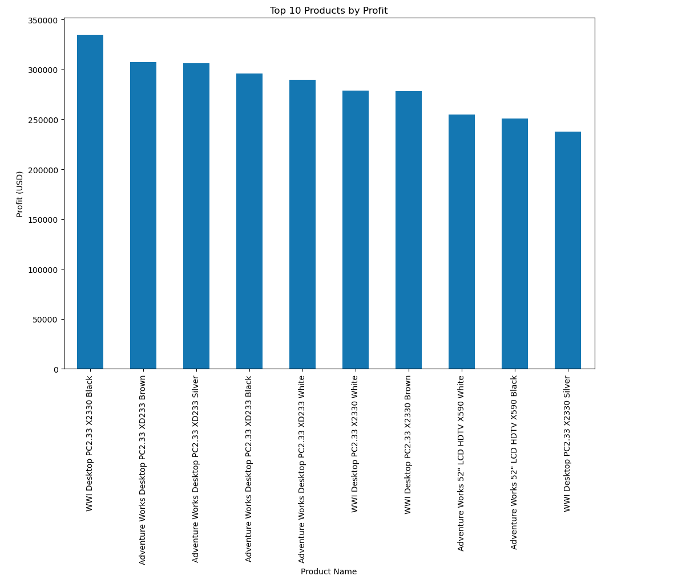
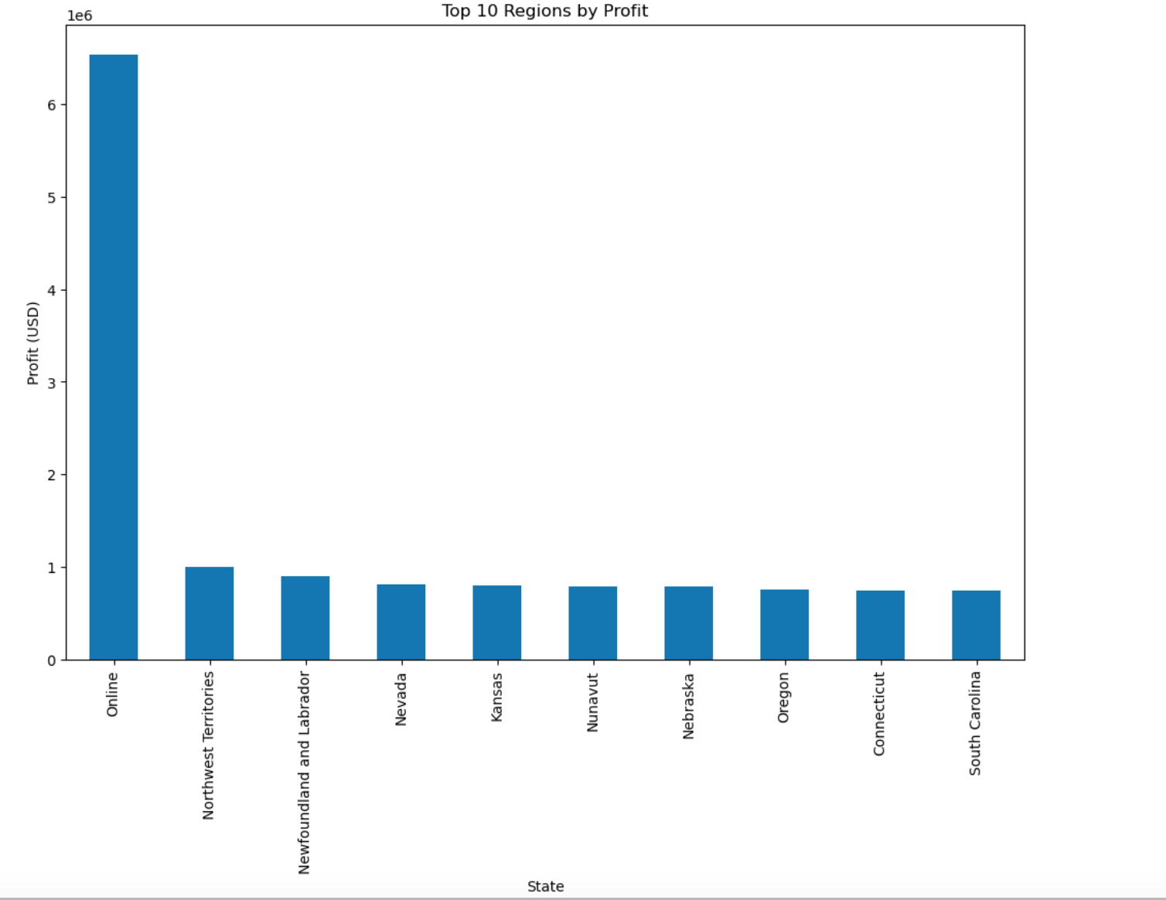
Profit Analysis
Top Product: WWI Desktop PC2.33 X2330 Black
E-commerce Dominance: Online sales are the most profitable
Focus Regions: Northwest Territories, Nevada, and Kansas

Slide 5
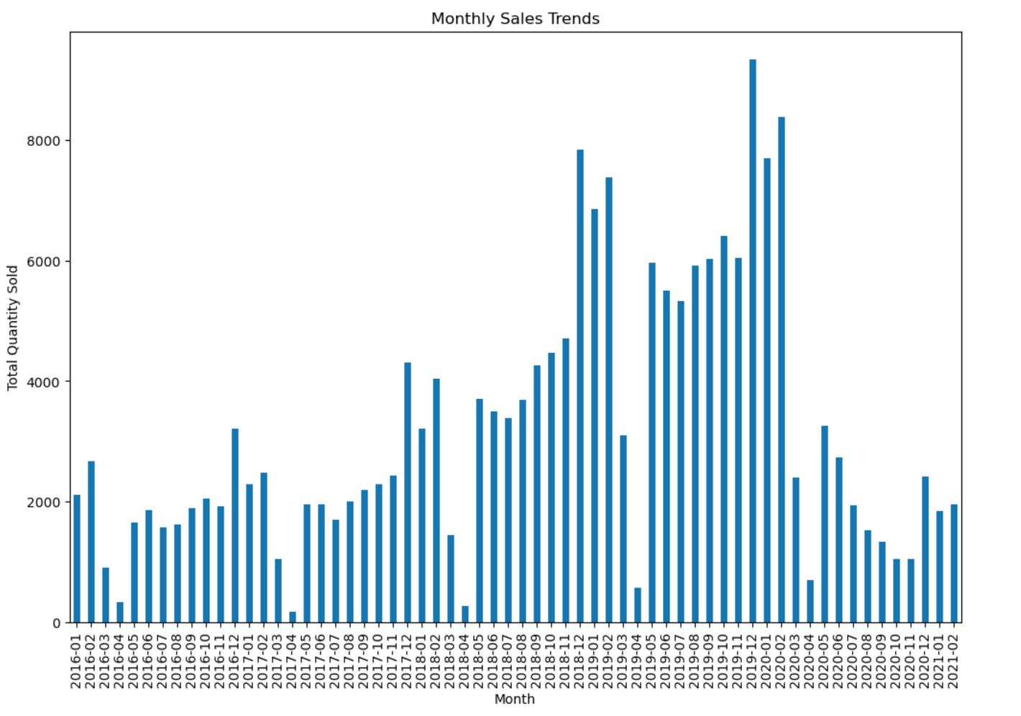
Monthly Sales Trends
Monthly sales trends show varying sales volumes throughout the year.
Notable peaks in sales are observed during certain months, particularly around the holiday season.
These trends are crucial for planning inventory and marketing strategies to maximize sales during peak periods.

Slide 6
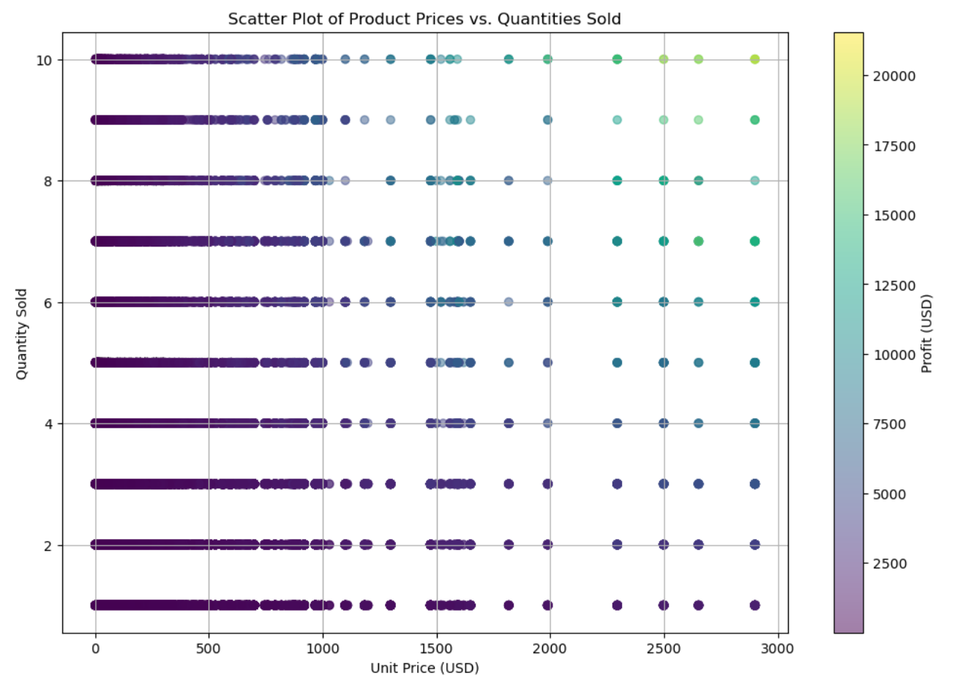
Price vs. Quantity Sold
The scatter plot shows the relationship between product prices, quantities sold, and profit margins.
Most products are sold at lower price points with varying quantities, while higher-priced products generate higher profits.

Slide 7

Opportunities:
Focus on High-Performing Products.
Improve Online Sales Strategies.
Target Regional Markets.
Leverage Seasonal Trends.
Pricing Strategy.

